Slide 1
Parallel Programming

Slide 2
Introduction
Overview
Open MPI
OpenMP
OpenHMPP / OpenACC

Slide 3
Parallel Programming

Slide 4
Parallel Programming
Overview
Main Goal: reduce execution time
Performance is not always linearly scaled
sometimes there's a lot of waiting
bottlenecks at resources (network, memory, disk)
some codes have a limit to its scale
Parallelizing unfit code can actually cause it to slow down

Slide 5
Parallel Programming
Mechanisms
Hyperthreading
Core/CPU multi-threading
GPGPU
Clusters
many machines networked together
Symmetric multiprocessing
shared memory; specialized network
Grid parallelism
many machines (sometimes whole clusters) networked over large geographic area
Cloud parallelism
computing as a service (AKA parallelism for rent)

Slide 6
Parallel Programming
Complications
Limited resources
NUMA restrictions
bandwidth (memory, network, I/O, ...)
data storage
Scheduling limited resources
thread scheduling (kernel level)
job scheduling
Security
cleanup between jobs
physical security
Reliability
As we scale up, probability of hardware failure increases

Slide 7
Parallel Programming
Cluster Hardware
Sometimes you're limited by what is available to you:
Hardware variance
homogeneous-hardware cluster
heterogeneous-hardware cluster
usually general CPUs mixed with GPUs
Networking Designs
Hardware: Ethernet; InfiniBand; ...
Topology: fat tree; torus; hypercube; ...

Slide 8
Open MPI

Slide 9

Open MPI
Overview
Open Source Message Passing Interface (MPI)
Used on some of the most powerful machines on the planet!
Cross-platform and many job schedulers supported
Pretty good support
esp. at LANL
Notes:
image: http://www.open-mpi.org/images/open-mpi-logo.png

Slide 10
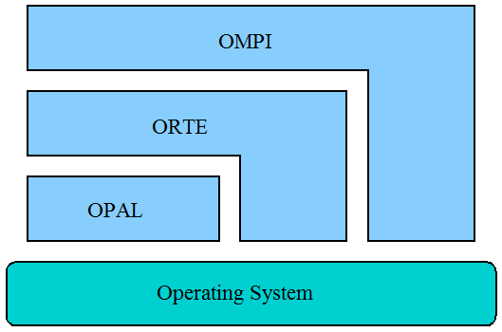
Open MPI
Overview
Plugin-based system
OMPI - MPI API
ORTE - Run Time Environment
OPAL - Portable Access Layer
Tunable through parameter settings
user tunable!
Notes:
image: http://www.dorii.eu/_media/resources:adaptation:middleware:openmpi_architect.png

Slide 11
Open MPI
Pros and Cons
Pros
Runs on shared and distributed memory architectures
Use on wide range of problems
compared to OpenMP
Local variables for each rank are easier to manage
Can launch itself
given a list of hosts and
using `orterun` over SSH
Can integrate with many schedulers
Cons
Steep learning curve
Difficult to upgrade existing code
Difficult to debug
requires special tools
Network bottlenecks are a headache

Slide 12
Open MPI
Installing
Don’t forget to configure your Infiniband fabric!
$ sudo yum install -y environment-modules openmpi openmpi-devel $ /usr/share/Modules/bin/add.modules $ echo "export MODULESHOME='/etc/modulefiles'" >> ~/.bashrc $ echo "export MODULEPATH='/etc/modulefiles'" >> ~/.bashrc
#Reload your shell, or `source` your ~/.bashrc script $ module load openmpi-x86_64
Notes:
question: does anybody know how to make the MODULESHOME and MODULEPATH variables default for everybody using bash?

Slide 13
Open MPI
Using
Directly call and use API functions
MPI_Init
MPI_*
MPI_Finalize
Compile using `mpicc`/`mpic++`
or `mpif77`/`mpif90`
Execute using `mpirun`

Slide 14
OpenMP

Slide 15

OpenMP
Shared memory multiprocessing
Part API
linked with libgomp
Part language extension
inline preprocessor directives tell compiler to parallelize a task
Notes:
image: http://www2.imm.dtu.dk/~bd/SciComp/openmp_lg_transparent.gif

Slide 16
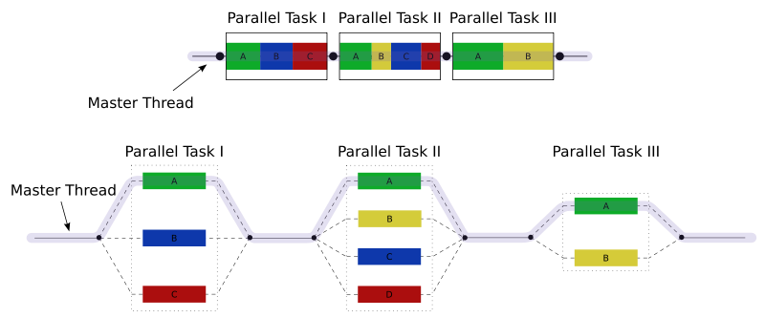
OpenMP
Notes:
image: http://en.wikipedia.org/wiki/OpenMP

Slide 17
OpenMP
Pros and Cons
Pros
Very portable
Easy to use and learn
esp. compared to MPI
Easy to upgrade areas incrementally
Pragma directives are ignored if library isn't available
Cons
Easy to shoot your foot off
beware race conditions!
Hard to debug
Localized to single shared memory architectures
Error handling unreliable
Not as efficient as MPI
Can slow down code that's unfit for parallelism

Slide 18
OpenHMPP / OpenACC

Slide 19

OpenHMPP / OpenACC
Overview
Uses similar syntax (directives) as OpenMP
Parallelizes code to use hardware accelerators (GPGPUs)
Portable code works with many architectures
Greatly simplifies GPU programming!
Notes:
image: http://media01.linkedin.com/media/p/1/000/105/26d/1289032.png

Slide 20
OpenHMPP / OpenACC
OpenHMPP
"Hybrid Multicore Parallel Programming"
Can directly compile to binary
Can also compile to CUDA/OpenCL source
great for upgrading legacy codes
OpenACC
Can directly compile to binary

Slide 21
OpenHMPP / OpenACC
Pros and Cons
Pros
Easy to use and learn
esp. compared to CUDA/OpenCL
Easy to upgrade areas incrementally
Pragma directives are ignored if library isn't available
Allows asynchronous transfers to GPU
Cons
Really hard to debug
Can slow down code that's unfit for GPU parallelism
massive parallelism (tens of thousands of threads)
Limited to CAPS, PGI and Cray compilers
none are free
none are cheap

Slide 22
Summary

Slide 23
Summary
Overview
Open MPI
OpenMP
OpenHMPP / OpenACC

Slide 24
Questions

